Slide 1
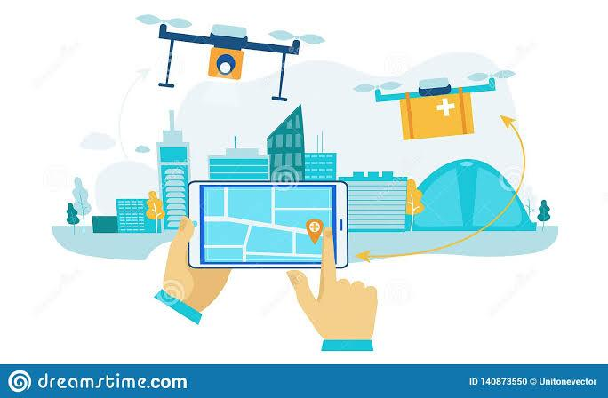
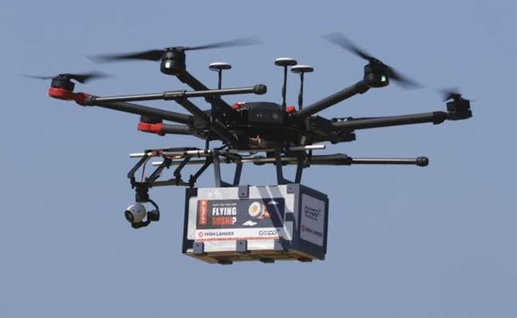
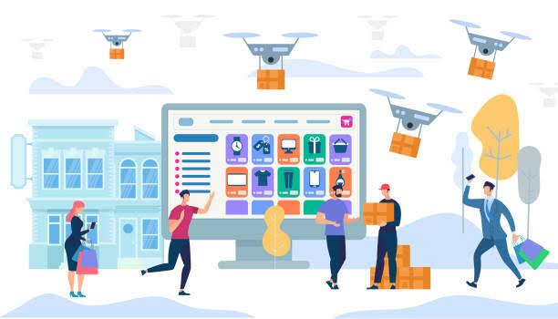
AIRDROP DELIVERY
READY TO REACH ,IN FEW MINUTES

Slide 2
BRAND – AIRDROP DELIVERY LOGO - TAGLINE - READY TO REACH, IN FEW MINUTES

Slide 3
ASSIGNMENT TAKEN HUMAN RESOURCE MANAGEMENT FOR AIRDROP DELIVERY . CASE UNDERSTANDING AIRDROP DELIVERY is a courier company that wants to expand their business and has ventured into Hyper Local Delivery Space, now they will be using drones, to deliver goods in the local areas, As a rule, all flying objects in India, needs to take permission from m (DGCA) Director General of Civil Aviation. Your company has all necessary permissions. and has also started trials with a few food delivery, pharma and internal local deliveries, the pilot testing was successful with positive feedbacks from the clients and company’s mission statement is also to provide ultimate benefits to the customers which is being met through this plan, thus company has decided to add a division that is entirely dedicated to delivery via drones . The company also has a certain amount of workforce dedicated to this division. What the company plans to do is achieve break even within the first year of its operations to consider whether venturing into this area is profitable or not, they also aim to establish their brand in the area of drone delivery in the market, in simple terms that AIRDROP DELIVERY aims to be a market leader.

Slide 4
BCS SOLUTION SUMMARY The vision of our courier company is to speed up deliveries and save time of all the peoples by providing all their necessities as food ,pharma medicines and other internal local deliveries .as our tagline says ready to reach in few minutes ,we are working for deliver the parcel in 15 minutes to 5 km destination and it will be quite faster with compared to road deliveries facing traffics ., since the company has decided to venture into drone delivery system, it is important to come up with excellent manpower to support the new service, so we are basically focusing on quality people other than quantity ,we are hiring hr recruitments ,finance management team , marketing sales manager ,software development team ,drone pilots ,technicians and support staff. The recruitment for the above-mentioned Job Positions will be done through external Recruitment. External Recruitment is the suitable for these job positions because the company requires certified, highly skilled candidates who have prior experiences with drone technology SOLUTION As per todays competitive world we are trying to speed up deliveries ,drone delivery is the biggest business opportunity and no other competitor is present now, we are being first and long lasting courier company . Swot analysis The staff recruitment Training plan and development Shift schedule plan

Slide 5
STRENGTH We are presenting new and unique idea of the delivery is the biggest strength of us Our local area and targeted audience Fast and safe delivery We are available as digital ,social websites and own application Customer service WEAKNESS As we are hiring the quality staff not quantity we are afraid of being lack of manpower OPPORTUNITY We have been able to conduct the market survey ,and we concluded the market base ,clients ,audience ,planning to grab the attention And being first to reach via drone delivery towards the customers by providing their needs ,parcels THREAT Being the first drone delivery courier company ,we can face challenges to getting deliveries Because some people can also think like it will not be easier and safe by airway delivery ,parcel can drop somewhere ,or if it is precious then the fear of getting damage .we have to gain trust of such customers .

Slide 6
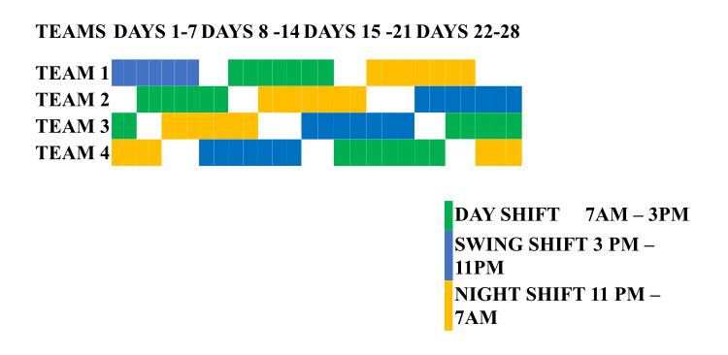
The staff recruitment and trainig plan development will be as shown in above solution . The shift schedule will be , The grid shows working and non-working days for each team in one repeat cycle. Day 1 usually starts on a Monday but it can be any day of the week. At the end of the cycle, the entire sequence starts over. Colour coded blocks represent assigned shifts (working days) while underlines represent non-working days. At least 2 days off after any 7 working days 3 days off after 7 consecutive night shifts 8-hr shifts

Slide 7
BEST EMPLOYEE AWARD FOR 2021-2022 We are providing BEST EMPLOYEE AWARD through out the year and they will get medals as well as bonus cash prizes ,the main motto of our organisation is to motivate all the staff and spread happiness in them . Best employee award

Slide 8
Drone Business & Goals for this Division are: To achieve Break-Even within first year of operations. Brand Establishment. Innovation in processes and product to become Market leader. CONCLUSION Airdrop delivery organisation having hr recruitment and training development plan are the important factors of growing our business and achieving our vision and making successful our mission , we are implementing new business opportunity in the market is the advantage of being the marketing leader .we are achieving the goals in coming year that is breakeven within year ,brand establishment ,occupying the market .

Slide 9
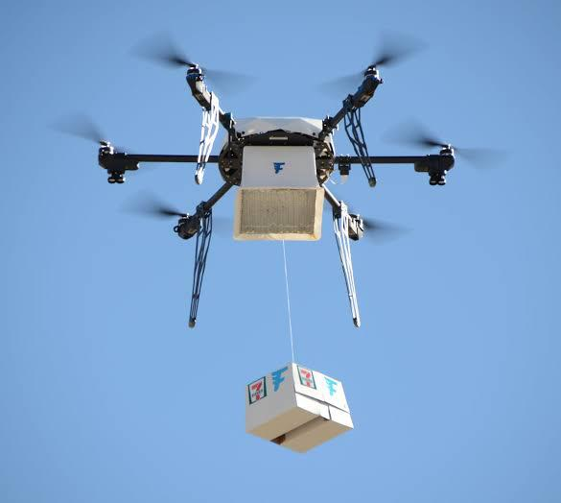
THANK YOU

